Slide 1

MGMT4419
Changing the Culture at
British Airways
Group 7
Cassandra Morin, Zobiah Khaliq, Kelsey Simmons, Lindsay Neal, Adam Addison, Luke Barry
Photo by Alex Azabache on Unsplash

Slide 2

Pillars of Strength
Leadership - Sir John King lead BA to a new culture and through a challenge of the government
Infrastructure - 15 years after WWII they single handedly opened air travel in Europe (Jick & Peiperl, 2011, p. 26)
Brand - Putting People First (PPF) changed BA to be customer focused (Jick & Peiperl, 2011, p. 26)

Slide 3
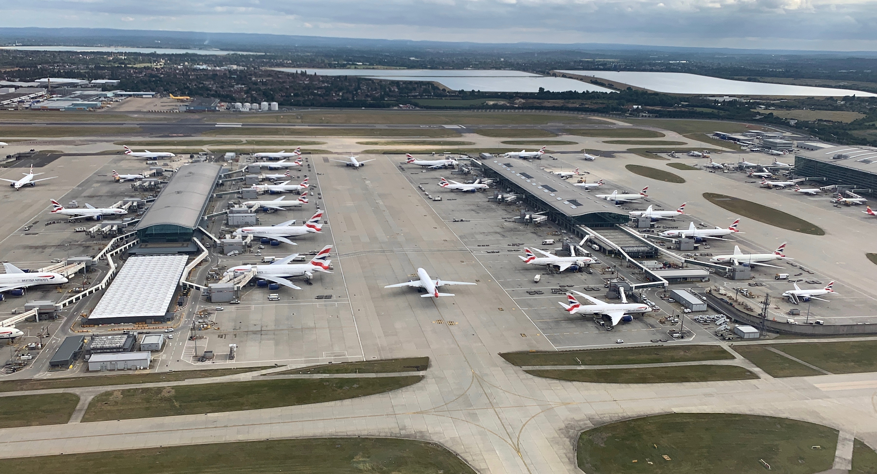
Business Model - Value Proposition
Corporate culture with a focus on customer service drives higher staff morale and market image (Jick & Peiperl, 2011, p. 25)
Global reach through acquisitions of British Caledonian and a stake of Sabena World Airlines (Jick & Peiperl, 2011, p. 34)
Cost cutting measures and privatization makes them one of the most profitable airlines (Jick & Peiperl, 2011, p. 25)

Slide 4
Primary Problem
Secondary Problem
Financial
Decrease in passenger volume
Low productivity
Overstaffed
Nearing Bankruptcy
Excessive costs
Poor company culture
Low morale
Division amongst employees
Organizational conflicts
Notes:
British Airways faced a number of problems that contributed to their financial problems and inefficiencies. Their main problem was a decrease in passenger volume and excessive expenses which was a result of poor management, overstaffing and excessive costs. Managers at British Airways were unable to focus on the changing environment and instead were constantly tasked with resolving internal conflicts and industrial problems (Jick & Peiperl, 2011, p. 28). The airline had a low productivity rate compared to others in the industry and was extremely overstaffed. Paired with a poor company culture, the problems at British Airways were detrimental to its success. Many of their employees viewed their job as one in the transportation industry and not service. This resulted in poor customer service and a bad reputation for the airline which contributed to the decreasing number of passengers.

Slide 5
PEST
Political British airways must comply with government laws and regulations of British and Europe in order to continue its operations (Jick & Peiperl, 2011, p. 33). United States flight regulations concerns and due to increase threat of terrorism British Airways had to stop fights (Jick & Peiperl, 2011, p. 33). The Civil Aviation Authority wanted to force BA and British Caledonia to swap air routes (Jick & Peiperl, 2011, p. 33). | Economic Due to British economic crisis British Airways had to sell their aircrafts (Explore our past, March 1981). Exchange rate difference between pounds and euros. Due to increased fuel prices and British recession British Airways had to cut staff, drop unprofitable routes and had to early retire older aircrafts (Jick & Peiperl, 2011, p. 29).
Social British Airways improved customer services and customer satisfaction by introducing the People First program in December 1983 (Jick & Peiperl, 2011, p. 31). Advertisement campaigns like “The World’s Favourite Airline” were introduced to change corporate image (Jick & Peiperl, 2011, p. 30). British Airways started to focus on globalization; they bought new aircrafts and introduced new routes (Jick & Peiperl, 2011, p. 33-34). | Technological Investing in new technology to cut costs and find new opportunities like introduction of first-class services (Explore our past, March 1989). Enhanced satellite and internet marketing. Online booking

Slide 6
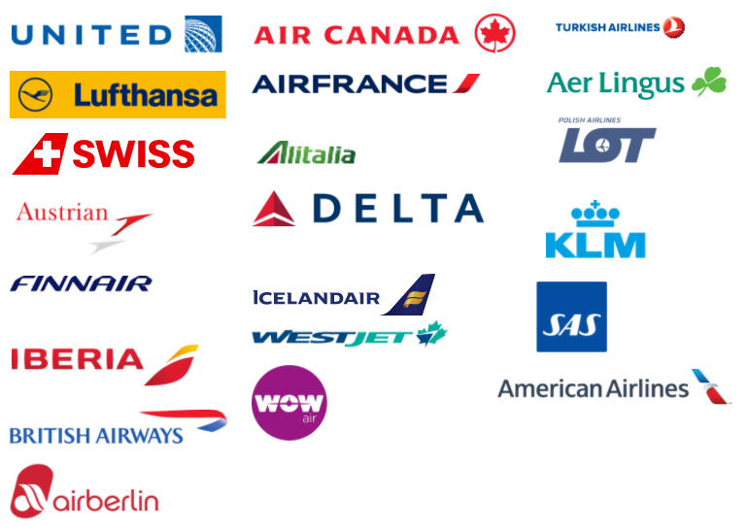
5 Forces
Threat of new Entrants
Threat Level: Low (1)
High Barrier to Entry
High Start up Cost
Regulatory Factors
Supplier Power
Threat Level: High (8)
Limited # of Manufacturers
Boeing, Airbus, & Embraer
*(BA.com, 2020)
Competition
Threat Level: High (8)
Swissair, United, KLM Dutch airlines, Scandinavian Airline system
British Caledonian
Merger of BEA and BOAC
Threat of Substitution
Threat Level: Medium (5)
No Substitution for Overseas
Bus, Train, Ferry
Different Customers
*(Back, V., paras 1-3, 2016)
Buyer Power
Threat Level: Low (3)
Limited buyer options
BA stronghold on travel destinations
Superior choice

Slide 7
SWOT
Strengths
Weakness
Poor customer services
Airline image in the marketplace
Management issues
Cost structure
Market competition
Financial problems
Large route network
Brand name and customer loyalty
Focused on providing high level customer services and customer experience
Skilled and highly qualified labour force
Opportunities
Threats
Increasing competition within the market
and new entries
Rising fuel prices
Exchange rates have devalued
Government laws and legislation
Provide training to management and staff
Improve customer services and customer experience
Increase marketing and advertising
Increase research and development

Slide 8

Financial Analysis
September, 1981: Watts and King launched their Survival Plan
staff by 9,000
June, 1982: Amendment to the Survival Plan staff
staff by 7,000
Impact on Operating Profit:
 | 1981 | 1982
Revenues | 2.06 Billion | 2.24 Billion
Expenses | 2.162 Million | 2.235 Billion
Operating Profit | (1.02) Million | 5 Million
Bank of England: Polymer Notes
Notes:
In September 1981, Watts and King launched their survival plan, which included a reduction of staff by 9,000. In June 1982 , British Airways management appended the survival plan to accommodate the reduction in staff by another 7,000.
By doing this, we can see below how much of an impact this had on operating profit. In 1981, British Airways was spending $1.05 in order to earn a dollar in revenue. In comparison, because of the appended survival plan, in 1982 they turned that around to be spending approximately $0.99 per dollar in revenue, mostly due to the reduction in staff. Although that doesn’t seem to be huge in terms of profit, this was a big deal in the turnaround of their business and profit structure.

Slide 9
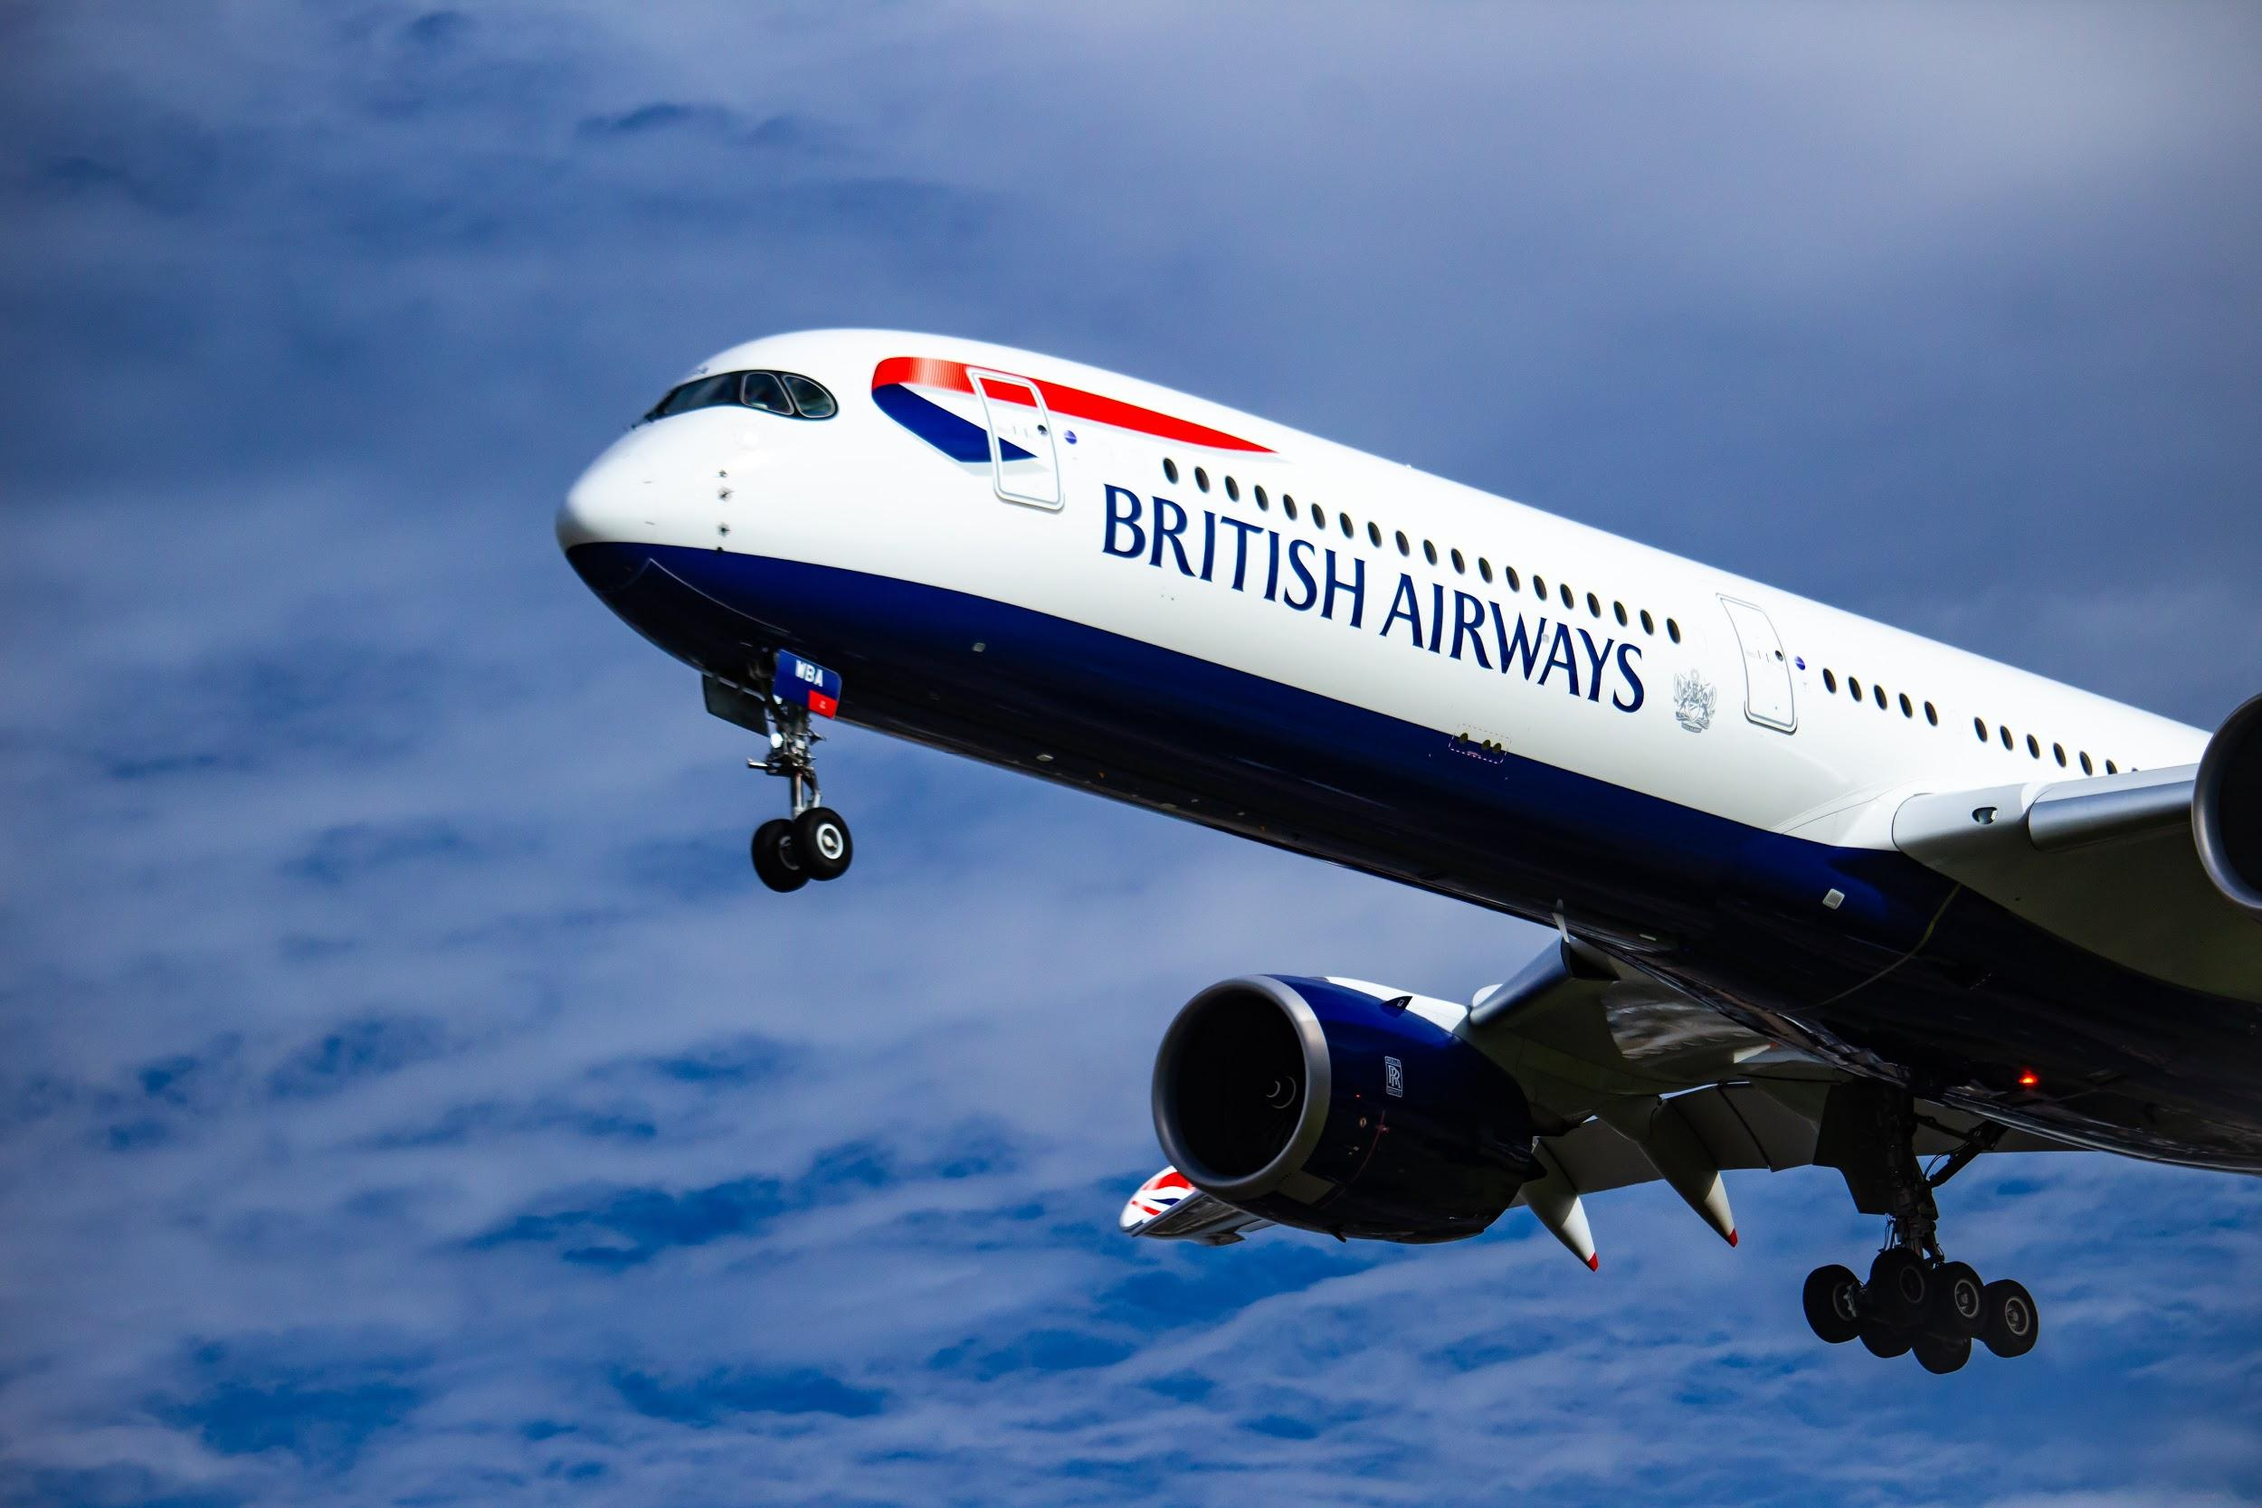
Key Success Factors of the Airline Industry
Structure
Organizational structure that fits how the business operates
A structure that is clearly laid out and communicates
Unifies the company and its market
Branding
Deliver on service excellence by determining what the customer wants before they know
Focus on the customer- what are they willing to pay and what is a competitive price.
Differentiation
Technology
Airlines need to be leaders in using technology for bookings, customer tracking, loyalty, in flight entertainment, and maintenance
Lead the way to gain a competitive advantage
Photo by Isaac Struna on Unsplash
Culture
A unification and team building of all employees at all levels will produce a culture of acceptance.
Managing employee expectations with strategic outcomes.
“With an effective culture in place, employee commitment can translate to tangible results and even reflect on financial statements” (Riwo-Abudho, Njanja, Ochieng, 2013).
Notes:
In order to be successful in the Airline Industry, we found the following 4 Key Success Factors.
Structure
The organizational structure should be clearly laid out with a clear chain of command in order to specify how the work is to be done. “Structure is a key success factor that unifies the organizations systems and how it caters to the market it serves” (Riwo-Abudho, Njanja, Ochieng, 2013)
Branding
Determining what the customer wants before a customer knows they want it, is the key to marketing and getting people to want to your brand
Ensuring there is a focus on the customer and what they are willing to pay for, while being competitive in nature.
Finding a way to differentiate themselves from others
Technology
Airlines need to be leaders in using technology for bookings, customer tracking, loyalty, in flight entertainment, and maintenance
These enhancements done in the right way will lead to a competitive advantage
Culture
A unification of all employees at all levels will produce a culture of acceptance and team building, which will help build a competitive edge. Effectively managing employee expectations requires keeping pace with the strategic outcomes of the organization.
“With an effective culture in place, employee commitment can translate to tangible results and even reflect on financial statements”. (Riwo-Abudho, Njanja, Ochieng, 2013)

Slide 10
GAP Analysis
Structure
“People were operating effectively, not necessarily efficiently”
Staff decreased in the 80s, resulted in organizational realignment
Management was “walking the talk”
A clear chain of command lacking
Feeling that too many managers
Branding
Improvement from “bloody awful to bloody awesome”
Customers felt the changes and began to believe in BA again.
“Strong commitment to service, higher morale, better market image” (Jick & Peiperl, 2011)
New advertising campaign. “World’s most respected airline”
Technology
In 1987, BA purchased a stake in Galileo, an advanced computer system
Continuous need to find the most effective and efficient technology for cost savings
Get the newest before your competition does
Culture
During the PPF training, BA managers and employees felt they were being “treated equally and interacted freely”.
Increase in morale, commitment to better service and increased market image
Still a need to continue to shift culture
Need all employees engaged or lags in customer service will continue to happen.
Notes:
In the early 90s British Airways had already overcome some of the financial trouble they had faced in the 80s. As they pushed forward to change, they brought in new leadership, taught new skills to all employees, changed organizational structures and adjusted the culture. This GAP analysis shows where British Airways was in the 90s as marked against the Industry key success factors.
Structure
As stated by a BA Manager “Productivity was not an issue. People were operating effectively, not necessarily efficiently”
BA decreased the number of staff in 1981-82. This helped them to realign the organization and make changes to the structure. There still were some bumps in the chain of command and the specifics of what all needed to be done to continue to change to be financially successful.
Management was “walking the talk” by going to training, answering questions and communicating as much as they could. A clear chain of command was still lacking as there was a feeling that there still was too many managers
Branding
Customer Service had improved from “bloody awful to bloody awesome”
British Airways was doing a good job at changing the customer service experiences after sending employees on successful high-end Putting People First training. Customers started to see and feel the changes in attitudes and beliefs by the employees and they began to believe in BA again.
“Strong commitment to service, higher morale, better market image” (Jick & Peiperl, 2011)
Although they were quite engaged in focussing on the training of employees, BA still needed to work on other aspects in order to build their brand up again. They enlisted in a new advertising company and spent money on a new ad campaign called.“World’s most respected airline”. This was their hope to shift the focus and differentiate BA from their competitors
Technology
In 1987, BA purchased a stake in Galileo, an advanced computer system which other airlines - KLM Dutch Airlines and Swissair - also supported.
There is a continuous need for BA to look to technology to find enhancements and cost savings when it come to systems for bookings, customer tracking, loyalty programs, in flight entertainment, and maintenance
By getting ahead of other airlines using technology, BA would be able to gain a competitive advantage
Culture
During Putting People First training, British Airways’ managers and employees felt they were being “treated equally and interacted freely”. They felt that they were being heard and the training was helping them personally as well as at work. There was more emphasis placed on feedback
Although the majority of the employees felt the morale was higher, there was a stronger commitment to service and a better market image (Jick), some employees felt there was still a way to shift the culture at BA. There wasn’t full unification and therefore a culture of acceptance wasn’t felt by all
Not all employees believe that everyone is “walking the talk”
Many felt that there were more managers now than before the cuts
There is a need to have all employees engaged or there will be lags in customer service.
A change in the Culture which led to employees changing their productivity and efficiency from “ there were a lot of people doing other people’s jobs and they were a lot of people checking on people doing other people’s jobs”. PPF helped employees change their thought patterns in terms of customers, their friends, co-workers and family. BA wanted employees to do things not because they were told, but because they saw a need and wanted to change their behavior to make day to day a better experience for themselves and customers. They wanted employees to show initiative, feel engaged and wanted not just management to “walk the talk” but employees to as well.

Slide 11
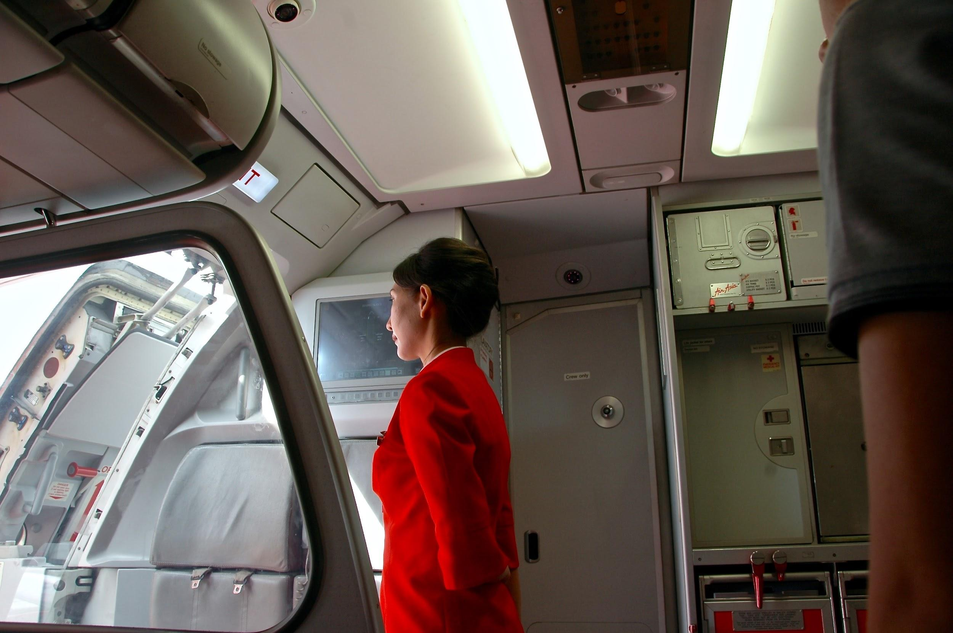
Alternatives
Primary - HIGH OPERATIONAL COSTS
Overstaffed - Organizational structure review
Decreased passengers - Utilize strategic alliances with other airlines
Technology - Cut costs by utilizing newer technology
Secondary - CULTURE
Continuous customer feedback
Evaluation and feedback with all staff to keep on top of morale
Progression towards all employees believing in the positive changes
Open communication between employees and within the organization
Photo by Jacky Watt on Unsplash
Notes:
Primary - HIGH OPERATIONAL COSTS
As British Airways was overstaffed they did significant cuts in the 80s. However as the organization began to change, new leaders came in and their new direction was taking place. However over time it seems that there was an increase in the number of new managers. An organizational structure review should be done to ensure that the company hasn’t become heavy on staff again.
In order to get customers back to travelling with British Airways, there is a need to utilize and work on gaining strategic alliances with other airlines in order to maximize routes and code-share.
Another high cost is inefficient technology. In order for British Airways to realize profit, they need to look to utilizing better more efficient Technology. They bought a share in a reservation system, but there is a continuous need to find better technological usage in order to have safe and efficient planes, up to date customers service software, tracking systems, etc. This will help realize a better profit margin.
Secondary - CULTURE
To ensure the culture is continuously changing for the better, British Airways should ask for feedback from customers. Customer needs and wants should be at the forefront so BA can ensure they are the airline of choice.
British Airways must continue to train, adapt and encourage employees for continued success and to keep morale high. Excellent customer service must continue to be apparent to customers.
Ensuring that employees are engaged and believe in outstanding customer service, so that the culture continues to moves forward in a positive manner and does not regress. There is a need to continue to positive change to win over staff that are still not believing BA has changed.
While cutting costs there is also a need to keep communication lines open with employees so they are aware of any changes and can feel secure and kept in the loop.

Slide 12
Develop Decision Criteria
Alternatives
 | Technological advances | Cut Costs/staff | Strategic Alliances | CRM
Structure | 3 | 5 | 3 | 1
Branding | 3 | 1 | 4 | 5
Technology | 5 | 1 | 3 | 2
Culture | 4 | 3 | 3 | 5
Total | 15 | 11 | 13 | 13
Key
Success
Factors
Notes:
*With the rating criteria that Neil suggested, the decision would seem to lead to favour Technological advances as the correct strategy to pursue. If we’d like to change that just let me know. I will justify all the ratings in the voice over and could just change the ratings if we want to go a different direction. (Adam - I think technology as a focus going forward is a good call)

Slide 13
Improving Revenue:
Invest in New Technology
Provide Unrivalled Customer Services
Be the Low Cost Provider
Use more Hub Connectivity
Cost Reduction:
Optimization
Benchmarking
Select Strategy
Cost Reduction
Improving Revenue
Notes:
Optimization: Utilization of company resources to maximize the profit or minimize the cost.
Benchmarking : Tools to define the problem and weakness in cost structure i.e Employees pay

Slide 14
Pillars of Strength - New Model
British Airways Brand - World class brand, signalling world class customer service and world wide reach of air routes
Technology - Acquiring reservation system, advancing internal technology to leverage new efficiencies
Customer service - Putting customers and staff first unifies the company to maintain world class status

Slide 15
Business Model - New Model
Improve the use and integration of technology - Keeping up to date on new technological advances in booking and route scheduling.
Continued focus on customer service - It is necessary to keep customer service top of mind amid growing competition among airlines.
Maintain the BA brand - Mover of the most passengers, and award winning airline for customer service.
Structure - Lean and mean, ensure management is not bloated. Lead by example through managers stepping in as needed, maintaining communication to all front line staff.

Slide 16
Implementation Plan
Source and review new systems for scheduling and booking. Conduct internal staffing review. Consolidate route gains from acquisitions.
Purchase and upgrade systems to increase efficiencies. Re-organize staff, and streamline as necessary to reduce costs. Review route offerings and find growth opportunities.
Ongoing systems review to continue efficiencies. Maintain customer service culture. Find and grow route offerings to increase reach.
3 Months - Consolidation and review
6 Months - Upgrade and seek opportunities
12 Months - Rinse and repeat for constant innovation

Slide 17

Risks
Poor customer service
Management Issues
Increasing Competition
Degraded Airline Image
Financial problems
This Photo by Unknown Author is licensed under CC BY-SA-NC
Notes:
British Airways has a number of risks it must overcome in order to continue being successful. One of the main risks to their success is that their customer service may revert to the poor service that plagued them in the 70’s. Having poor service would cost them customers and customer recommendations. The prior poor service from their staff was a result of a negative company culture (Jick & Peiperl, 2011, p. 26). The culture lacked morale and a cohesive and collaborative atmosphere. If they were required to radically change the culture British Airways also risks having their current staff be resistant to change. They may be too attached to their current culture to be willing to accept the changes. If company culture remains an issue, British Airways risks having their brand image go back to the “bloody awful” image they were known for in the 1980’s (Jick & Peiperl, 2011, p. 25). They have worked hard to improve their perception in the market and having a degraded image could directly impact the company’s financials. If the company slipped back into their previous detrimental habits of a bloated staff, too many pay increases, expensive administration, and staff clubs they risk financial problems similar to those they suffered in the early 80’s (Jick & Peiperl, 2011, p. 29). Hypercompetition is an external risk that British Airways faces due to increased competition from other Airlines. British Caledonian attempted to take over smaller British Airway routes, although they were unsuccessful the Civil Aviation Authority recommended increased competition for the airline (Jick & Peiperl, 2011, p. 33). This opens the door to more airlines taking market share from British Airways.

Slide 18
Mitigation
Risk | Strength
Poor customer service | Putting people first campaign
Degraded Airline Image | Brand name and customer loyalty
Management Issues | Colin Marsh
Financial problems | Privatization
Increasing Competition | A determined leader who will defend the company against competitors
Notes:
In order to know if British Airways could overcome the risks they face, it’s important to compare their risks against their strengths. Fortunately for British Airways, their company has many strengths that offset their risks. Their poor customer service has been eliminated by their “putting people first” campaign. This training program has allowed employees to learn how to provide great customer service. The program was warmly received by British Airways employees and was the catalyst to an radical cultural change (Jick & Peiperl, 2011, p. 31). One of British Airway’s strengths is their well known name and customer loyalty. Although their image suffered in the 70’s, they have been able to maintain loyal customers and revamp their reputation. Having a poor image can hurt a company financially, however, British Airways was able to mitigate this by doing a radical change of their staffing levels, fleet, customer service and company culture. In order to provide effective and efficient management while British Airways underwent their extensive company culture overhaul, Colin Marsh as brought on as chief executive. Colin was known for his commitment to completely overhauling British Airways’ customer service (Jick & Peiperl, 2011, p. 31). Colin was able to change the culture from one of complacency and low morale to one where employees felt engaged and a part of British Airways’ success (Jick & Peiperl, 2011, p. 31). With increasing fuel costs, overstaffing and increased government regulations, British Airways needed to overcome their financial problems. They did this by becoming a private company. After privatization, British Airways was able to focus on globalization, partnerships and acquisitions. This new strategy eliminated their former financial troubles. One of the ways BA was able to deter competition was through the determination and passion of their chairman Sir John King. Faced with the risk of losing smaller routes to British Caledonian King fought relentlessly to preserve BA’s routes. He was so motivational in his commitment to BA’s success that he was able to inspire thousands of people to sign petitions and write their MP’s opposing the loss of any routes (Jick & Peiperl, 2011, p. 33). His innovative take on customer service, company culture and the globalization of British Airways put distinctive a competitive advantage between British Airways and their competitors.

Slide 19
References
BA.com. (2020). Fleet Facts. British Airways.com. Retrieved From: https://www.britishairways.com/en-gb/information/about-ba/fleet-facts
Back, V. (2016). Getting To Belgium From London: Plane, Train Or Bus?. Pommie Travels. Retrieved From: https://www.pommietravels.com/getting-to-belgium-from-london-plane-train-or-bus/
Explore our past: 1980 - 1989: About BA: British Airways. (n.d.). Retrieved from https://www.britishairways.com/en-ca/information/about-ba/history-and-heritage/explore-our-past/1980-1989
Jick, T. D., & Peiperl, M. A. (2011). Managing change: cases and concepts (Third ed.). Paul Ducham.
Riwo-Abudho, M., Njanja, L., & Ochieng, I. (2013). Key Success Factors in Airlines: Overcoming the Challenges.

